Slide 2
Caltech Financials Data Warehouse Labor Distribution (LD)

Slide 3
Agenda
LD Row-Level Security
Data Design, Concepts, and Logic
LD Reports
Accessing the Reports

Slide 4
LD Row-Level Security

Slide 5
LD Row-Level Security
OBI utilizes Oracle’s LD Security.
Access to an Assignment based on your access to the combination of Orgs and Person Types.
You might not have access to all assignments for one person.
Note: Some access based on specific individuals.
Exception: NIH Salary Cap Campus report security is at the PTA-level, i.e., not LD Security.
Report only includes percentages, no distributions.
LD Access handled by IMSS Info Security.
Notes:
LD Row-Level Security
OBI utilizes the same security used for Oracle’s LD Security.
Access to an Assignment based on your access to the combination of Orgs and Person Types.
People can have more than one assignment number.
You might not have access to all assignments for one person.
Note: Some access based on specific individuals.
Exception: NIH Salary Cap Campus report security is at the PTA-level, i.e., not LD Security.
Report only includes percentages, no distributions.
LD Access handled by IMSS Info Security.

Slide 6
Data Design, Concepts, and Logic

Slide 7
Data Design, Concepts, and Logic
Integrated with Costs & Commitments.
Design based on campus users’ data needs.
Designed for drill-through integration.
LD That May Hit Suspense to LD Schedule Lines
Effort Commitment Scheduling to LD Schedule Lines
Cost Details (Drill) to LD Query (Export)
Notes:
Data Design, Concepts, and Logic
Labor Distribution data is integrated with the Costs & Commitments data.
The overall design was based on the data needs and business processes of the campus users.
The overall Financials Data Mart design rests on the ability to drill from one report to another for more information. For example:
LD That May Hit Suspense to LD Schedule Lines
Effort Commitment Scheduling to LD Schedule Lines
Cost Details (Drill) to LD Query Export (must have LD access, of course)

Slide 8
Data Design, Concepts, and Logic
Lived Name
Common name rather than formal name
Elion, Trudy B instead of Elion, Gertrude Belle (Trudy)
Used on all reports
Employee Name, Supervisor Name
Award, Project, and Task Managers
Costs and Commitments: Cost Incurred For
Updates Throughout When Changed in Oracle
When using the copy/paste functionality for entering a parameter, best to use the UID or Assignment #
Notes:
Data Design, Concepts, and Logic
Common Name is a person’s preferred name and is used rather than the formal/legal name.
Elion, Trudy B instead of Elion, Gertrude Belle (Trudy)
Common Name is used on all reports
Employee Name, Supervisor Name
Award, Project, and Task Managers
Cost Incurred for within the Costs and Commitments
When a name is changed in Oracle, it will also update throughout the OBI reports.
If you are using the copy/paste functionality for entering a parameter it is better to use the UID (Caltech ID #) or Assignment # rather than the name.

Slide 9
Data Design, Concepts, and Logic
OBI includes all distributions, including those LDA transactions that zero out.
LD Query (Export) has both Batch Name and Comments.
Lots of PTA information available.
Customizing your report enables you to include fields supporting your business procedures, including:
Funding Source Award #, Award Name, and Award End
Project Name and Project End
PTA Status and PTA End
Task Name
Notes:
Data Design, Concepts, and Logic
OBI includes all distributions, including those LDA transaction that zero out and LD Adjustments (LDAs) that have been submitted but not yet approved.
LD Query (Export) also includes both the Batch Name and Batch Comments.
There is a lot of PTA information available for you to customize your report.
Customizing your report enables you to include fields that support your business procedures.

Slide 10
Data Design, Concepts, and Logic
Certain columns are calculated.
OBI uses logic similar to the logic used when costing LD pay distributions in Oracle Grants Accounting.
Amt Grp for Calc - Amount Group for Calculation
Summary of distributions by Assg # and Pay Period.
May or may not match the actual check amount.
Amount used for calculating Assg % for Pay Period.
Exp Item Date (calculated field)
Does not always match Exp Item Date in Cost Details.
Note: Logic isn’t magic
Notes:
Data Design, Concepts, and Logic
Pay Distributions are stored in Oracle day-by-day. These daily distributions are summarized when they move from the Labor Distribution module into Grants Accounting for the costing process.
Certain columns are calculated during the nightly load to OBI.
OBI uses logic similar to the logic used when costing LD pay distributions in Oracle Grants Accounting.
Amt Grp for Calc – Amount Group for Calculation
This is a calculated field that is the summary of distributions by Assignment # and Pay Period.
This calculation may or may not match an employee’s check amount.
This is the amount that is used for calculating the assignment percentage (Assg %) for the Pay Period, assignment, PTA, element, expenditure type, and expenditure item date.
Exp Item Date is also a calculated field and will not always match the Exp Item Date that is in Cost Details.
NOTE: The Logic is not magic. While the overall amounts match between LD and Cost Details, there may be discrepancies for data such as expenditure item date.

Slide 11
Data Design, Concepts, and Logic
Pay Period Name
Pay Period similar to the Reference # in Cost Details.
LD Query Pay Period: 16 2021 Bi-Week
Cost Detail Ref #: 2021 Bi-Week 16
New Column: Pay Period Sort
Reorders the CY, Payroll Type, and Payroll #.
2 2021 Calendar Month vs 2021 Monthly 02
FY Period
Assists in comparing LD to Cost Details
Note: Logic isn’t magic
Notes:
Data Design, Concepts, and Logic
Following is some additional information about specific fields.
Pay Period
The LD Pay Period is similar to the Reference # in Costs Details
16 2021 Bi-Week in LD and 2021 Bi-Week 16 for Ref #
Users had wanted the ability to sort in Cost Details on the Pay Period.
In support of the desire to sort by Pay Period after exporting to Excel, the column Pay Period Sort was added to the LD Query.
Reorders the CY, Payroll Type, and Payroll # in the Pay Period Name.
For example: 2 2021 Calendar Month vs 2021 Monthly 02
FY Period is also available to help compare distributions to cost details
NOTE: The Logic is not magic.

Slide 12
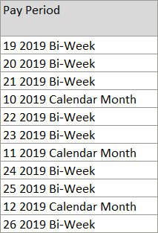
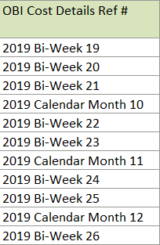
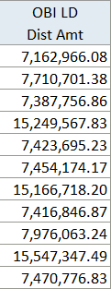
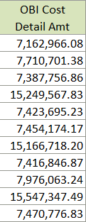
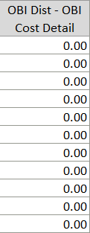
LD and Cost Details: Comparison
Notes:
While individual detail may have differences between the LD Query and Cost Details, the overall summary amounts are correct.
In other words, the Expenditure Item Date may not match perfectly, but the overall summary totals over time will match.

Slide 13
LD Reports

Slide 14
LD Reports
LD Schedule Lines
Information about employee labor distribution schedules.
LD To Hit Suspense
Information about pay distributions that may hit suspense in the next payroll periods.
LD Query (Export)
Daily distributions summarized by Assg #, Pay Period, Element, Exp Type.
Several available versions to select for customizations.

Slide 15
LD Reports
Award Effort Commitment - Background
In a grant proposal a commitment of effort is made for each key personnel on that proposal.
If the proposal is awarded, then that commitment is entered at the award level.
Differences over a certain percentage require approval from the funding agency.
Employee’s effort is the sum of effort across all awards with the same Funding Source Award #.

Slide 16
LD Reports
Effort Commitment Balance
Compares percentage of effort committed to the actual distribution percentage, including cost share.
Effort Commitment Scheduling
Shows the percentage of effort committed and the current percentage scheduled across Oracle Awards with the same Funding Source Award Number.

Slide 17
LD Reports
NIH Salary Cap - Background
Congress voted in legislation that, starting in 1990, no person paid on an NIH award could be paid more than an Executive Level II salary, i.e., the amount members of congress are paid.
People are still paid their full salary, however, so the amount over the Salary Cap must be paid with other non-federal funds.
Amount changes each federal fiscal year and people’s salaries also change each year. For this reason, compliance should be managed month-by-month.

Slide 18
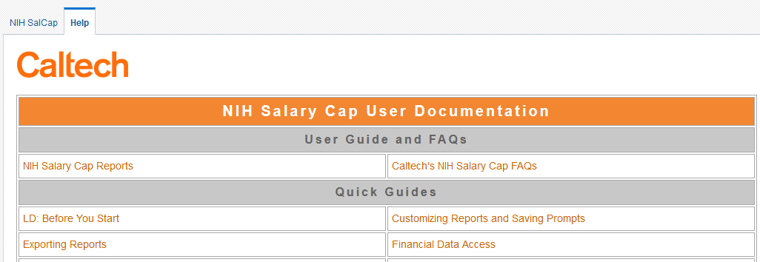
LD Reports
NIH Salary Cap reports compare employee’s Caltech pay proposal to NIH Salary Cap and includes the amounts to use for LD Adjustment.
Help tab of these two reports includes NIH Salary Cap-specific user guides.
Includes step-by-step instructions on using report data for entry into the Oracle LD Adjustment forms.

Slide 19
LD Reports
NIH Salary Cap Campus (PTA Security)
Only LD report that uses PTA-level security.
Does not include distribution amount or salary information.
NIH Salary Cap Detail (LD Security)
Includes distribution amount and salary information.

Slide 20
LD Reports – College Work Study
Used by Financial Aid Office.
Requires Financial CWS User role.
CWS Distributions
Distributions made to students with CWS Awards.
Includes credit amount to the PTAs for distributions.
CWS Student Awards
Information about the award made to each student.
Contains running summary total of distributions made on the student’s award.

Slide 21
Accessing the Reports

Slide 22
Accessing the Reports
OBI is Part of access.caltech Single Sign-On
Link: Data Warehouse (OBI)
VPN is Required
Pop-up Windows Must be Allowed for OBI
obi-proxy-prod-a.caltech.edu
Notes:
To access OBI go to access.caltech, login, scroll down to Data Warehouse (OBI), and click on the link, which will open a new browser tab.
NOTE: In order to use OBI you must either be on the Caltech internet OR use VPN.
In addition, your browser must allow pop-up windows for OBI, i.e., for obi-proxy-prod-a.caltech.edu.

Slide 23
Accessing the Reports
To access the reports, click on a role under MY DASHBOARDS.
In the Report Listing each Subject Area has a tab.
For this training we will be using the Labor Dist tab.
Notes:
Accessing the Reports
To access the reports, click on a role under MY DASHBOARDS on the OBI home page. This will open the Report Listings.
Each of the first few tabs represent a Financials Subject Area. These subject areas include:
Costs & Commitments: A list of reports that are based upon the Costs and Commitments detail.
Installments: A list of reports based upon Award Installments detail.
Labor Distribution: A list of reports based upon data from the Oracle Labor Distribution module.
Summaries: A list of reports based upon PTA financial Budget and Cost information.
The remaining tabs are for other reports and information not specifically for one of the Subject Areas
The Info tab lists reports that are about data not specific to each of the Subject Areas, for example, information about Awards, Exp Categories and Types, and Funding Sources.

Slide 24
Caltech Financials Data Warehouse OBIHelp@caltech.edu OBI Training Documentation OBI Training Schedule
Notes:
For more information about OBI please see the user documentation on the Help tabs or go to:
Questions, issues, and requests for enhancements may be sent to OBIHelp@caltech.edu
OBI User Documentation: http://imss.caltech.edu/services/administrative-applications/data-warehouse-obi/obi-userguides
OBI Training: http://www.imss.caltech.edu/services/administrative-applications/data-warehouse-obi/obi-training-schedule

Slide 25
caltech.edu

