Slide 1


Slide 2
Caltech Financials
Data Warehouse
OBI Introduction

Slide 3
Agenda
What is OBI?
Data Warehouse Design
Data Concepts
Financial Subject Areas
OBI Security
Accessing Reports
Tips, Hints, and Frequently Asked Questions
Demo

Slide 4
What is OBI?

Slide 5
What is OBI?
OBIEE = Oracle Business Intelligence Enterprise Edition
  At Caltech we call it OBI for short
Set of tools for data warehousing and data analytics with Oracle e-Business integration
Development tools for bringing together data from multiple sources
  Extract, Transform, and Load
End user tool for running reports for analysis
Notes:
OBIEE = Oracle Business Intelligence Enterprise Edition. We generally refer to it by the shorter acronym, OBI.
OBIEE is simply a set or a group of tools that are used for data warehousing and data analytics.
Most of the tools are used for bringing together the data from multiple sources, i.e., extracting, transforming, and loading the data into the data warehouse.
The end user tool in the browser is the tool that you will use for running reports for data analysis.

Slide 6
Data Warehouse
Design

Slide 7
Data Warehouse Design
Integrates a comprehensive set of Financials data
Design based on campus users’ data needs
Drill-through Integration
  Cost Detail to Invoice, PO, or WIC
  LD To Hit Suspense to LD Schedule Lines
You will have more information available
  Less reliant on Finance staff to research items
Notes:
OBI integrates a comprehensive set of Financials data.
There is now the ability to connect a cost to the Procurement invoice, see the payment date, and look at details about the PO.
Design is based on campus users’ data needs.
Design enables the ability to drill through from one report to another for additional information.
With all this additional available information in an easy-to-use format you will be less reliant on Finance staff to research questions you might have about a cost.

Slide 8
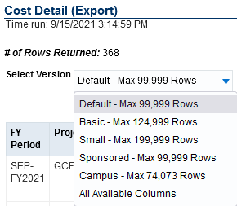
Data Warehouse Design
Design enables better search capabilities
  Reports have more filters
  Starting to look at variable prompts
    Prompt lets you decide how it will work
Many reports have multiple versions
  Versions have different columns, formats, etc.
Notes:
The new design enables better search capabilities, e.g., the reports have several filters available.
Most of the non-drill or Export reports have multiple versions available within the one report.
These versions have different columns available, formats, etc.
They can also be customized to add (include) and remove (exclude) columns, etc.

Slide 9
Data Warehouse Design
Invest the time to get to know the report versions and filters
  Default version might not be the best one for you
  Other versions may suit your needs better
Customizing your report
  Customizing allows you to include/exclude columns, save parameters, etc.
  Two user documents available in Help that will walk you through how to customize a report
Notes:
We highly recommend that you invest the time to get to know the report versions and filters.
The default version, i.e., the version that first returns when you run the report, might not fit your business practices.
However, other versions that you can select in the report may suit your needs far better.
Customizing allows you to take the version that best suits your needs, and then make it even better.
For example, you can include/exclude (i.e., add or remove) columns, save your parameters, etc.
For more information on Customization see the Quick Guide Saving Prompts and Customizing Reports which is available on the Help tab.
Before you start, see the Tips of the Day document, Customizing Your Report for ideas to make the customization process be as efficient as possible.

Slide 10
Data Concepts

Slide 11
Data Concepts
Costs and Commitments
  Cost Incurred For
    Logic links transaction to the person or group
  Providers
    Every transaction now has a Supplier and Provider
    P-Card transactions have Merchant as Provider
  Enhanced Expenditure Comment
    Tax lines linked to original transaction
    Transactions, including tax lines, can be rolled up
  Reference #
    Inv #, PO #, WIC, WO #, Pay Period
Notes:
For more information about the data concepts within Costs and Commitments, please attend the Costs and Commitments Training
Cost Incurred For (CIF)
Who was that cost for? Logic links the transaction to the person or a group.
Providers.
Who provided the cost, e.g., who was the supplier or merchant or IC service organization?
An expenditure comment that:
Doesn’t include all the “noise” of the full expenditure comment that is in Oracle (and in OBI).
Focuses, for example, just on the comment about an internal charge, and not on all the other items like service organization, customer, who to contact, etc.
Enables the roll-up of the item’s cost and its tax lines into a single line.
Reference # can be the Invoice #, PO #, WIC, Work Order #, the Pay Period
For more information about the logic used for OBI, see the Data Logic Guides available both on the Help tabs in the OBI Report Listings and on the IMSS website.

Slide 12
Data Concepts
Labor Distribution
  Pay Period more in line with Costs and Commitments
  Pay Period Sort is YYYY – Payroll – Period # to aid with sorting on the field
  LDA information available in LD Query (Export)
Notes:
For more information about the data concepts for the Labor Distribution, please attend the Labor Distribution Training

Slide 13
Data Concepts
Lived Name
  Common name rather than formal name
    Elion, Trudy B instead of Elion, Gertrude Belle (Trudy)
  Used on all reports
    LD: Employee Name, Supervisor Name
    Award, Project, and Task Managers
    Costs and Commitments: Cost Incurred For
    NOTE: We can only use the Lived Name for the Cost Incurred For when we’ve been able to link the Cost Incurred For value to an HR record.
Notes:
For more information about the data concepts within Costs and Commitments, please attend the Costs and Commitments Training
For more information about the data concepts for the Labor Distribution, please attend the Labor Distribution Training

Slide 14
Financial
Subject Areas

Slide 15
Financial Subject Areas
A Subject Area represents the type of analysis
  Analysis of numbers over time
Each subject area has their own purpose,
row-level security, and set of reports
OBI Financials has four subject areas
  Costs and Commitments
  Labor Distribution (LD)
  Award Installments
  Summaries
Notes:
Financial Subject Areas
A Subject Area represents the type of analysis that the user intends to do.
This is analysis is on numbers, for example costs or pay distributions, over time.
Each subject area has their own purpose, row-level security, and set of reports.
OBI Financials has four subject areas:
Costs and Commitments
Labor Distribution (LD)
Award Installments
Summaries

Slide 16
Financial Subject Areas
Costs and Commitments
  Cost Details (Drill, Export and Pivot)
  GA Invoice Detail and GA PO Detail
  Outstanding Commitments
  Cost Transfers
Security
  PTA-level
  Compensation Expenditure Types
    Transaction still appears, but with $0
Training: Costs and Commitments
Notes:
The first Subject Area is Costs and Commitments.
Costs and Commitments
Cost Detail (Drill), which allows you to drill to more information about a cost.
Cost Detail (Export), which is designed for ease of export, six different views of the data, and alternative prompts for more flexible searches.
Cost Detail (Pivot), which is brand new and this report pivots costs over time.
Outstanding Commitments, which quickly lists active commitments based on a variety of search prompts.
Cost Transfers (both Campus and Finance), which are used as part of the Cost Transfer application process.
Security
PTA-level combined with Salary or No Salary, which is based on the Expenditure Types setup.
The Exp Type setup has a Compensation? flag, which indicates if the expenditure type is related to payroll or not.
If a user does not have access to the Exp Types flagged as compensation, then the transaction still appears on the report, but the Cost will equal $0.
For more info about Costs and Commitments, see the Training schedule for times for Costs & Commitments.

Slide 17
Financial Subject Areas
Labor Distribution
  LD Query (Export)
  LD Schedule Lines
  LD That May Hit Suspense
  Effort Commitment Balance
  Effort Commitment Scheduling
  NIH Salary Cap Detail (LD Security)
  NIH Salary Cap Campus (PTA Security)
Security: Oracle LD
Training: Labor Distribution
Notes:
Labor Distribution
LD Query (Export): Similar to the report in Cognos, but has more parameters and columns available, including Batch Name and Comments
LD Schedule Lines: Information about the schedule lines that determine the percentage of the total assignment or element pay to which PTA.
LD That May Hit Suspense: Let’s you know which pay distributions that may hit suspense if the payroll were to be run today.
NIH Salary Cap Detail and Campus: Both reports were designed to assist with maintaining compliance with the NIH Salary Cap.
Detail version includes salary and distribution amounts and uses the Oracle LD security for row-level security.
Campus version does NOT include salary and distribution amounts and uses the PTA-level security.
Row-level Security for Labor Distribution is based on the Oracle LD security and must be given via Oracle LD Security.
For more information about Labor Distributions, please see the Training schedule for times for Labor Distribution.

Slide 18
Financial Subject Areas
Award Installments
  Important part of the PTA budget creation
Reports
  Award Installments
  Award Installments (GB)
  Award Installments (Gift-Grants-Endow)
    Requires Division User or Finance User role
    Ability to drill to Advance gift receipt info
Security: Award-level
Training: Summaries and Award Installments
Notes:
Award Installments
A set of reports based on Award Installments, which is the first step in budgeting your PTA in Oracle.
These reports include:
Award Installments
Basic report.
Can be used for all funding types.
Award Installments (GB)
Designed only for GB Awards.
Includes the ability to search by Award Division.
Award Installments (Gift-Grants-Endow)
Only available for Division and Finance user roles
Includes the ability to drill to Gift Receipt information loaded from the Advance system

Slide 19
Financial Subject Areas
PTA Summaries
  Security: PTA-level
  Training: Award Installments and Summaries
Reports
  PTA Summary - Comparison of Budget and Spend
    Budgets and balances summarized at Exp Categories
    Costs and commitments summarized at Exp Types
    Able to drill down to details for costs and commitments
  FY Summary Over Time
    Includes current summaries with Period Costs over time
    by each FY Period
Notes:
PTA Summaries
Security is at the PTA-level
Training: Award Installments and Summaries
PTA Summary - Comparison of Budget and Spend
Budgets and balances summarized at the Expenditure Categories
This is because budgets are entered in Oracle at the Exp Category
Costs and commitments summarized at the Expenditure Types
FY Summary Over Time
Includes the current summaries with the Period Costs over time by each FY Period.

Slide 20
Financial Subject Areas
PTA Summaries Reports (cont.)
  ITD Summaries and FY Summaries (Export)
    ITD version only includes awards managed on ITD basis
    FY version only includes awards managed on FY basis
  PTA Summary - ITD (Drill) and - FY (Drill)
    Able to drill to costs for the period
    Both reports include all awards regardless of basis
  Awards for Consideration
    Returns list of awards that meet the criteria in the prompts
    Excellent for finding awards with balances < $###
Notes:
PTA Summaries Reports (Cont.)
ITD Summaries (Export) and FY Summaries (Export)
Both reports are designed for ease of export.
Both reports include several versions for viewing the results.
ITD version only includes awards that are managed on an Inception to Date (ITD) basis.
FY version only includes awards that are managed on a Fiscal Year (FY) basis, e.g., General Budget PTAs.
PTA Summary - ITD (Drill) and PTA Summary - FY (Drill)
Both reports enable you to drill to costs for the period.
Both reports include all awards, regardless of the type of ITD or FY basis.
Awards for Consideration
Returns list of awards that meet the criteria in the prompts
Excellent for finding awards with balances < $###

Slide 21
OBI Security

Slide 22
OBI Security
User roles determine access to reports
Financial data mart has three main roles
  Financial Campus User
  Financial Division User
  Financial Finance User
Additional security at data (row) level
  PTA-level & compensation for Costs & Commitments
  PTA-level for PTA Summaries
  Award-level for Installments and Award Summaries
  Oracle LD for Labor Distribution
Notes:
There is three “types” of security combined that makes up your OBI user security.
The first is your access.caltech security (see next slide). This is what gives you the access to the OBI home page.
The second is your user role, which determines which Report Listing you see. The Report Listing controls your access to individual reports.
The third is the row-level security. This determines the rows to which you have access.
The row-level security is different for each of the subject areas, as mentioned in previous slides.

Slide 23

OBI Security
VPN is required (or on the Caltech internet)
OBI is part of access.caltech Single Sign-On
  Link: Data Warehouse (OBI)
Pop-up windows must be allowed for OBI
  obi-proxy-prod-a.caltech.edu
Clicking on the access.caltech link opens a new browser window for the OBI Home Page
Notes:
To access OBI go to access.caltech, login, scroll down to Data Warehouse (OBI), and click on the link, which will open a new browser tab.
NOTE: In order to use OBI you must either be on the Caltech internet OR use VPN.
In addition, your browser must allow pop-up windows for OBI, i.e., for obi-proxy-prod-a.caltech.edu.

Slide 24
Accessing Reports

Slide 25
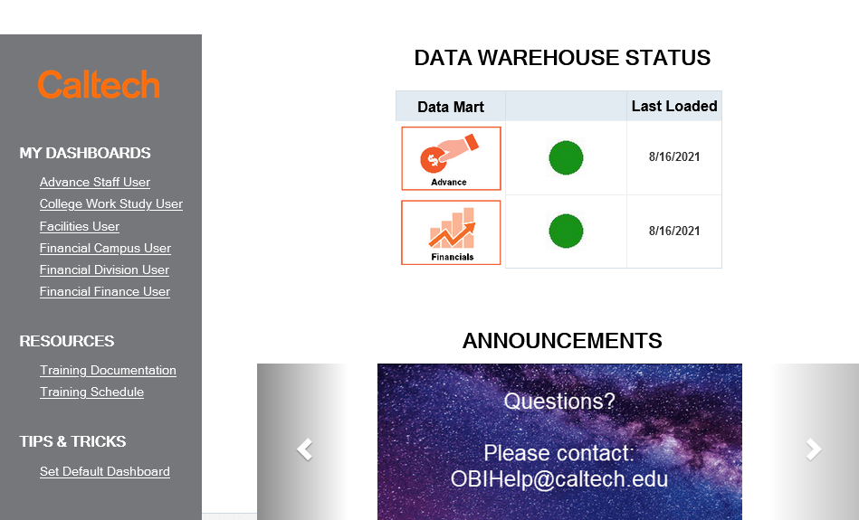
Accessing the Reports
OBI Home Page has three sections:
  DATA WAREHOUSE STATUS at the top-center
  Scrolling ANNOUNCEMENTS are at the bottom-center
  User roles under MY DASHBOARDS link to Report Listings
Notes:
The status of the Data Warehouse loads is in the top-center of the OBI home page.
The bottom-center has scrolling Announcements.
In the gray section on the left are links to the dashboards containing the Report Listings to which you have access.
Our email address for any questions is OBIHelp@caltech.edu

Slide 26
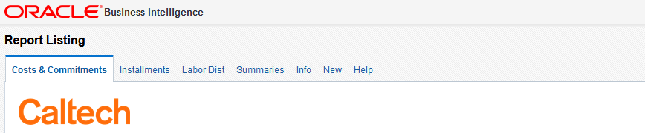
Accessing the Reports
Clicking on the user role will open the Report Listing for that user role
The Report Listings have several tabs
These tabs are used to organize the reports and other information
Notes:
Clicking on a User Role under My Dashboards will open with the Report Listing dashboard for that user role.
The Report Listings have a series of tabs that are used to organize the reports and other information

Slide 27
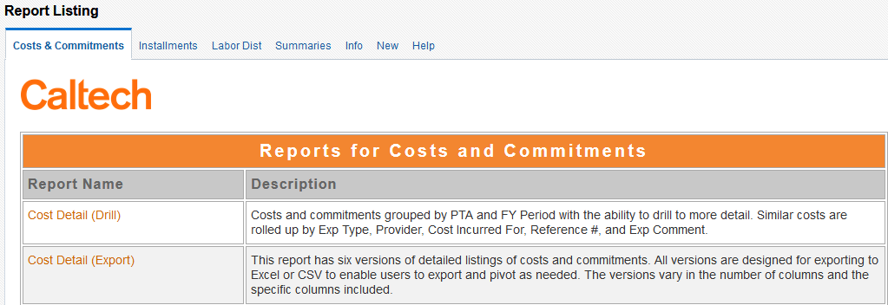
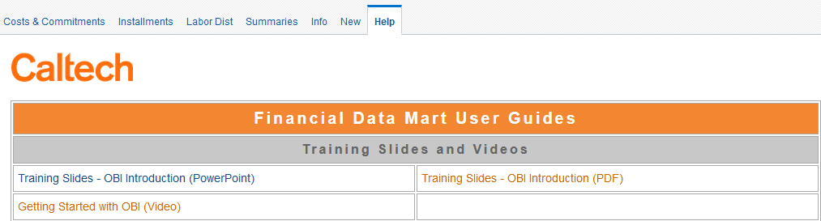
Accessing the Reports
Examples of tab content
Notes:
These are just example screenshots of a couple of the tabs:
Costs & Commitments: Notice the report names and the descriptions of each.
Help: Contains links to all the available documentation, which is also on the IMSS web site.

Slide 28
Accessing the Reports
Each Subject Area has a tab
  Costs & Commitments
  Installments
  Labor Distribution
  Summaries
Info: Reports about data rather than numbers
  Awards
  Exp Categories and Types
  Funding Sources
Notes:
Each of the first few tabs represent a Financials Subject Area. These subject areas include:
Costs & Commitments: A list of reports that are based upon the Costs and Commitments detail.
Installments: A list of reports based upon Award Installments detail.
Labor Distribution: A list of reports based upon Labor Distribution information, e.g., Schedule Lines and Pay Distributions
Summaries: A list of reports based upon PTA financial Budget and Cost information.
The remaining tabs are for other reports and information not specifically for one of the Subject Areas
The Info tab lists reports that are about data not specific to each of the Subject Areas, for example, information about:
Awards
Exp Categories and Types
Funding Sources

Slide 29
Accessing the Reports
New
  List of latest enhancements to OBI Financials, including new or modified reports
  New user documentation
Help
  Training Slides and Video
  User and Data Logic Guides
  Quick Guides
  Report Guides
  Tips of the Day
  Troubleshooting Guides
Notes:
The New tab lists recent enhancements made to OBI Financials.
The enhancements are listed by date
Tip: Click on this tab each week or so to see if there have been new enhancements made since the last time you checked.
The last tab, Help, has a list of user guides including:
Training Slides and Video: Includes the slides used for today, complete with notes.
User and Data Logic Guides: Financial User Guide and documents detailing the logic used for transforming the Financial Data Mart data values.
Quick Guides: Short documents on specific topics, many of which are included in the Financial Data Mart User Guide.
Report Guides: Documents specific to individual reports.
Troubleshooting Guides: Documents to assist with common issues that users may run into

Slide 30
Accessing the Reports
Types of Reports
  Drill
    Links within report navigate to more information
    Example: Cost Detail to Invoice, PO, WIC, etc.
  Export
    Designed for further formatting in Excel
    Several versions to select within a single report
Notes:
There are two types of reports:
Drill
Links within the report to navigate to more information in a new browser tab
Example: Cost Detail to Invoice or PO or WIC, etc.
Export
These reports are designed to export to Excel where you can add further formatting, pivot on the data, etc.
These reports typically have more than one version to select from with each version having different columns, orders, etc.

Slide 31
Tips, Hints, and
Frequently Asked Questions

Slide 32
Tips and Hints
Embrace the User Documentation
  For example, learn how to customize your reports
  This investment could save you time overall
Explore the versions of views within a report
  Export reports have multiple versions of the data shown
  Get to know them before customizing the report
Notes:
Tips and Hints
Embrace the User Documentation
Challenge your assumptions about the data
Learn how to customize reports
This investment could seriously save you time
Explore the versions of views within a report
The reports designed for export to Excel have multiple versions each with different columns included, ordered, etc.
Get to know them BEFORE customizing the report

Slide 33
Tips and Hints
Using Prompts
  Sometimes Less is More
    Searching for a specific PTA? Don’t also enter Project #.
    Too many prompts can decrease performance with no benefit
  Use Search for the Prompts
Exporting
  Stick to Excel or CSV
  Excel: 2,000,000 cells (# of columns X # of rows)
  CSV: 500,000 rows
Notes:
Using Prompts: Sometimes Less is More
If you are searching for a single PTA there is no reason to enter the Project # or Award # as well
Entering too much could lead to data entry errors
Using Prompts: Use Search for the Prompts
The search offers freedom on character case as well as automatically applying a wildcard at the beginning and end
However, the prompt entered when running the report must be exact, e.g., the correct case, etc.
You’ll also be able to discover alternative versions of values, e.g., BOON P or Boon, Priscilla or Boone Precilla or Preiscilla Boon or Pboon or P Boon, etc.
Exporting
Stick to Excel or CSV because OBI exports the pixel size rather than font size, which means it will be much smaller than expected
Excel: Max output is 2,000,000 cells (e.g., 200,000 rows with 10 columns)
The nice thing is that exporting to Excel keeps all the formatting
CSV: Max output is 500,000 rows, regardless of number of columns
This type of export includes ALL of the columns in the report – even those that are hidden or excluded

Slide 34
FAQ
How Do I Save My Prompts/Filters?
  Please see Quick Guide - Saving Prompts and Customizing Reports
  Available both on the Help tabs and IMSS website
How Do I Schedule a Report to be Emailed?
  This functionality is not available in OBI
  Enhancement request submitted to Oracle
Notes:
Frequently Asked Questions (FAQ)
How Do I Save My Prompts/Filters?
Please see the Quick Guide – Saving Prompts and Customizing Reports
Available on the Help tab as well as the IMSS website at http://www.imss.caltech.edu/services/administrative-applications/data-warehouse-obi/obi-userguides
Tip: Before you start customizing see the Tip of the Day, Customizing Your Report on the Help tab as well as the IMSS web site at http://www.imss.caltech.edu/documents/17895/TOTD-Customizations.pdf
How Do I Schedule a Report to be Emailed?
This functionality is not available in OBI
Enhancement request has been submitted to Oracle, but not likely to happen

Slide 35
FAQ
What is the Cognos Timeline?
  GA and LD Reports in Cognos are No Longer Supported
    This includes reports such as PTA Cost Details, PTA Summaries, LD Query, and LD Schedule Lines
    These financials have not been updated since June 2021
  HR and PO/AP Data Marts continue to be loaded
  and supported
Who do I contact for help?
  Please use OBIHelp@caltech.edu for any questions you may have!
Notes:
Frequently Asked Questions (FAQ)
What is the Cognos Timeline?
Reports in the Cognos Grants Accounting (GA) and Labor Distribution data marts are no longer supported
This includes reports such as the PTA Cost Details, PTA Summaries, LD Query, and LD Schedule Lines
HR and PO/AP data marts in Cognos continue to be supported

Slide 36
Caltech
Financials Data Warehouse
OBIHelp@caltech.edu
OBI Training Documentation
OBI Training Schedule
Notes:
For more information about OBI please see the user documentation on the Help tabs or go to:
Questions, issues, and requests for enhancements may be sent to OBIHelp@caltech.edu
OBI User Documentation: http://imss.caltech.edu/services/administrative-applications/data-warehouse-obi/obi-userguides
OBI Training: http://www.imss.caltech.edu/services/administrative-applications/data-warehouse-obi/obi-training-schedule

Slide 37


