Slide 2
Caltech Financials Data Warehouse Award Installments and Summaries

Slide 3
Agenda
OBI Security
Data Design, Concepts, and Logic
Award Installments
Summaries
Accessing Reports

Slide 4
OBI Security

Slide 5
OBI Security
OBI User Roles determine access to reports.
Financial data mart has three main roles:
Financial Campus User
Access to a specific set of reports.
Financial Division User
Same access as Campus User, plus additional reports.
Financial Finance User
Same access as Division User, plus additional reports.
Notes:
OBI User Roles determine to which reports you will have access
The Financial data mart has three main roles:
Financial Campus User
Majority of users have this role
Access to a specific group of reports
Financial Division User
Smallest user group
Same access as the Campus User, plus additional reports
Sees both roles on their dashboard
Financial Finance User
Same access as Division User, plus additional reports
Sees all three roles on their dashboard
Reason: So the Finance Users can go into a report with the same navigation as a Campus User
Tip: Use the Finance role unless specifically assisting somebody on campus

Slide 6
OBI Security
Row-level security controls specific data access
PTA Summaries: PTA-level
PTA-level
Can be given by Organization, PI, Award, Award-Project, Project, Project-Task, and PTA
Specific values can also be excluded
Award Installments & Award Summaries
Award-level
Can be given by Organization, PI, and Award
Specific values can also be excluded
Notes:
While the roles control to which reports you have access, there is additional security on the data itself
Row-level security controls the specific data access
PTA Summaries
PTA-level access determines to which PTAs a user can see
Can be given by Organization (Project, Task, and Award Org), PI (Project, Task, and Award Manager), Award, Award-Project, Project, Project-Task, and PTA
Specific values can also be excluded, e.g., All BBE PTAs, except for these specific GB PTAs
Tip: Give access at the highest level possible, e.g., Award instead of PTA
Award Installments and Award Summaries
Award-level determines to which Awards a user can see
Can be given by Organization (Project, Task, and Award Org), PI (Project, Task, and Award Manager), and Award
Specific values can also be excluded, e.g., All BBE PTAs, except for this specific GB award
For more information see the Quick Guide Financial Data Access.

Slide 7
Data Design, Concepts, and Logic

Slide 8
Award Installments
Installments represent the amount that can be spent.
Entered in Oracle at the Award.
Broken into the Direct and Indirect amounts.
Not entered at the Expenditure Category.
Installment funds the Project(s).
Award Installment should equal Project Funding.
Installments are not linked to budget versions.
Installments and Project Funding are used for validation on budget entry.
Notes:
Award Installments represent the amount that can be spent for the award.
For example, when a PI gets an award from NIH, NSF, DOE, NASA, etc., an installment is created in Oracle for the amount of the sponsor’s award.
All Oracle awards have installments, not just sponsored awards.
The installment is created at the Award
An award can have more than one installment. In fact, most awards have multiple installments.
Installment entry is also used by Finance to document changes made to budgets, e.g., moving money from one task to another or deobligating funds.
The installment is broken up into direct and indirect amounts.
Unlike budgets, installments are not entered at the Exp Category-level.
After the installment is created, the project(s) is Funded.
This amount is not broken into direct and indirect amounts. Just the total amount.
The Award Installment amount should equal the Project Funding amount.
Installments are NOT LINKED to budget versions.
Award Installments and Project Funding are used for validation on budget entry.

Slide 9
Award Installments – PTA Creation
2
3
1
Create Installment
Fund Project(s)
Create Project and Task(s)
PTA(s) CREATED
1
Create Draft Award-Project Budget
Create Award
4
Submit Budget
7
5
Baseline Budget
6
Notes:
The Award Installment is part of the initial PTA Creation process.
All of the following must happen before a PTA is created in Oracle:
First the Award is created, and the Project and Task(s) is created – it doesn’t matter which order – No Linkage.
After the award has been created, an Installment is added to the award – No Linkage.
From that installment one or more projects are funded – No Linkage.
This does NOT link the project and award, but it does populate the list of values for Project Numbers when you navigate to Award Budgets.
If an error has been made and the wrong Project # was used when the Project Funding was entered AND a budget version has not yet been baselined, then the Project Funding can be deleted and replaced with a correct Project #.
Funding is NOT done at the task level.
After the Project is Funded then the Draft Budget can be created and saved – Still No Linkage.
The budget is then Submitted – Still No Linkage.
The last step is to Baseline the budget.
Only after the budget is baselined is the PTA Created.

Slide 10
Award Installments
Financial Campus User
Award Installments
Award Installments (GB)
Financial Division User
Award Installments (Gift-Grants-Endow)
Ability to drill to Advance gift receipt info
Financial Finance User
Additional reports for validating data entry
Notes:
Award Installments
A set of reports based on Award Installments, which is the first step in budgeting your PTA in Oracle. These reports include:
Award Installments
Basic report.
Can be used for all funding types.
Award Installments (GB)
Designed only for GB Awards.
Includes the ability to search by Award Division.
Award Installments (Gift-Grants-Endow)
Only available for Division and Finance user roles
Includes the ability to drill to Gift Receipt information loaded from the Advance system

Slide 11
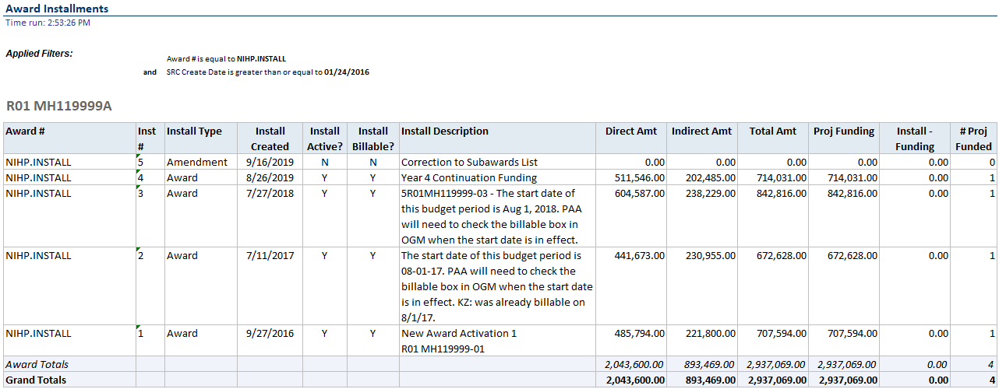
Award Installments Report
Notes:
This is an example of the award installments for an Award.
There are five installments for this award.
One project is funded by each installment line, except for Installment #5.
In this example, the Total Amt (i.e., the total installment amount) equals the Project Funding for each line.
On occasion a data entry error is made during the creation of the installment and project funding.
It is a good idea to check these on occasion to make sure that your amounts match.
#5 was entered for procedure reasons to indicate that there were modifications made elsewhere.
NOTE: Ignore the total on the # Proj Funded column because it is summing up all the rows. However, only one project is funded.

Slide 12
Summaries
Summaries for previous periods are a snapshot in time.
Should only be run for one financial period at a time.
Roll-up vs Actuals
Projects can be setup with a hierarchy of parent and child tasks.
Actuals are the amounts (budgets, costs, and balances) for the individual tasks.
Roll-ups are the summary of the actuals for the parent and child tasks.
Notes:
Summaries
Summaries for previous periods are a snapshot in time.
Should only be run for one financial period at a time.
Roll-up vs Actuals
Projects can be setup with a hierarchy of parent and child tasks.
Actuals are the amounts (budgets, costs, and balances) for the individual tasks.
Roll-ups are the summary of the actuals for the parent and child tasks.

Slide 13
Summaries
PTA Example for Roll-up vs Actuals
Notes:
PTA Example for Roll-up vs Actuals
The Task # column shows a PTA hierarchy with two top tasks, SAL and EXP
SAL has to child tasks
EXP also has two child tasks, but also has two grandchild tasks under EXP.OTH
Column names without – RU indicate that the column includes actual data, i.e., the data entered at that task.
Budgets can be entered at any level, but once that happens, budgets can only be entered at the same level going forward.
The vast majority of Caltech budgets are entered at a top task.
Costs and Commitments can only happen at the lowest task.
Column names with – RU indicate that the column is a Roll-up, i.e., the sum of the actuals for the tasks and any tasks below it in the hierarchy.
You need to understand the meaning of these columns because summarizing on the wrong values can greatly misstate values for an award.

Slide 14
Budget and Spend
Budgets
Entered in Oracle at the Expenditure Category.
Can be entered at any level in the PTA Hierarchy.
Usually entered at the top task.
Balances
Budget minus Costs minus Commitments.
Because of the Budget, Balances are also at the Expenditure Category level.
Notes:
Budget and Spend
Budgets
Entered in Oracle at the Expenditure Category.
Can be entered at any level in the PTA Hierarchy.
Usually entered at the top task.
Balances
Budget minus Costs minus Commitments.
Since the Budget is entered at the Expenditure Category level, Balances must also be at the Expenditure Category level.

Slide 15
Budget and Spend
Spend
Costs and Commitments are at the Expenditure Type level and roll-up to the Expenditure Category.
Costs and Commitments can only “hit” the lowest tasks of the Project work breakdown structure and then roll-up to the parent tasks.
Summary reports are generally at the Expenditure Category.
Exception: PTA Summary – Comparison of Budget and Spend.
Notes:
Budget and Spend
Spend
Costs and Commitments are at the Expenditure Type level.
Expenditure Types are grouped by Expenditure Category, therefore, Costs and Commitments can roll-up to the Expenditure Category.
Note: Costs and Commitments can only “hit” the lowest tasks of the Project work breakdown structure (aka, hierarchy) and then roll-up to the parent tasks.
Summary reports are generally at the Expenditure Category level.
Exception: PTA Summary – Comparison of Budget and Spend.

Slide 16
PTA Summary – Comparison of Budget and Spend
Notes:
In Oracle Grants Accounting budgets are entered at the Expenditure Category while spending is done at the Expenditure Type. Most of the OBI summary reports are at the Expenditure Category level. However, this report brings together the budget and balance, which is at the Expenditure Category, with the costs and commitments totaled at the Expenditure Type. In addition, clicking on the non-zero Period Costs or Commitments will take you to more information about the amounts. For PTAs managed on a Fiscal Year (FY) basis, please use the FY tab, and for Inception-to-Date PTAs use the ITD tab. Please Note: For performance reasons, only the Current Period and Previous Period are available for this report.

Slide 17
ITD vs FY
Most awards at Caltech are managed on an Inception-to-Date (ITD) basis.
Gifts and Endowments
Plant Funds
Sponsored Awards
Some awards are managed on a fiscal year (FY) basis.
General Budget
Using FY data for an ITD Award may provide misleading information.
Notes:
Inception to Date (ITD) vs Fiscal Year (FY)
Most awards at Caltech are managed on an Inception-to-Date (ITD) basis, i.e., budgets, costs, and balances are based on activity since the inception of the Award.
Gifts and Endowments
Plant Funds
Sponsored Awards
Some awards are managed on a fiscal year (FY) basis, which means the budgets and costs are zeroed out on the first day of the new Fiscal Year.
General Budget
Using FY data for an ITD Award may provide misleading information.

Slide 18
FY Summaries
Caltech has its own logic for FY Summaries
FY Budgets are based on the month into which the budget was entered for the fiscal year
FY Budget Allocation: Entered in SEP-FY####
FY Carry Fwd Balance: Entered in NOV-FY####
FY Prior Commit: Entered in OCT-FY####
FY Budget = Sum of All Entry for FY
FY Costs are sum of costs for periods in fiscal year
FY Budget Summaries have no context for ITD
Notes:
The concept of Fiscal Year Summaries does not exist in Oracle Grants Accounting. Instead, Caltech has created a logic and budget entry procedure to support the reporting of FY Summaries.
FY Summaries
FY Budgets are entered into one of three months within the fiscal year.
FY Budget Allocation: Entered in SEP-FY####
FY Carry Forward (Fwd) Balance: Entered in NOV-FY####
FY Prior Commitments (Commit): Entered in OCT-FY####
FY Budget = Sum of budget entry into OCT through SEP for the fiscal year
Period Budget Activity concept is only applicable for Inception to Date (ITD) reporting.
FY Costs are the sum of the costs for the periods within the fiscal year.
FY Budget Summaries have no context for ITD-managed accounts and may cause confusion.

Slide 19
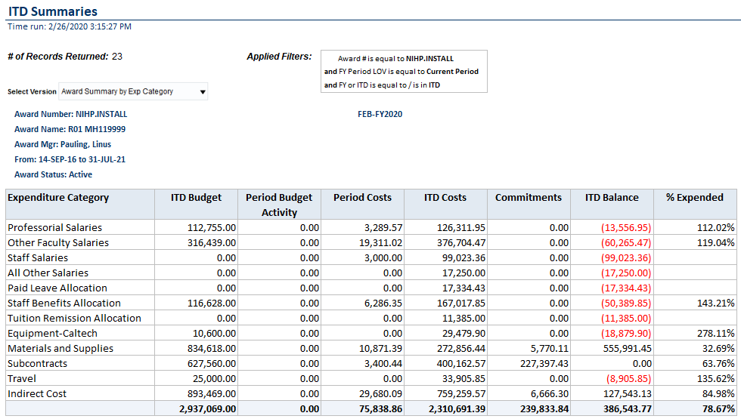
PTA Summary Report
Notes:
This is the current PTA Summary for the Award.
Notice that the budget is entered at the Expenditure Category-level, not at the Award-level, like the installments.
As expected, however, the ITD Budget matches the total installments.

Slide 20
Accessing the Reports

Slide 21
Accessing the Reports
OBI is Part of access.caltech Single Sign-On
Link: Data Warehouse (OBI)
VPN is Required
Pop-up Windows Must be Allowed for OBI
obi-proxy-prod-a.caltech.edu
Notes:
To access OBI go to access.caltech, login, scroll down to Data Warehouse (OBI), and click on the link, which will open a new browser tab.
NOTE: In order to use OBI you must either be on the Caltech internet OR use VPN.
In addition, your browser must allow pop-up windows for OBI, i.e., for obi-proxy-prod-a.caltech.edu.

Slide 22
Accessing the Reports
To access the reports, click on a role under MY DASHBOARDS.
In the Report Listing each Subject Area has a tab.
For this training we will be using the Installments tab and Summaries tabs.
Notes:
Accessing the Reports
To access the reports, click on a role under MY DASHBOARDS on the OBI home page. This will open the Report Listings.
Each of the first few tabs represent a Financials Subject Area. These subject areas include:
Costs & Commitments: A list of reports that are based upon the Costs and Commitments detail.
Installments: A list of reports based upon Award Installments detail.
Labor Distribution: A list of reports based upon data from the Oracle Labor Distribution module.
Summaries: A list of reports based upon PTA financial Budget and Cost information.
The remaining tabs are for other reports and information not specifically for one of the Subject Areas
The Info tab lists reports that are about data not specific to each of the Subject Areas, for example, information about Awards, Exp Categories and Types, and Funding Sources.

Slide 23
Caltech Financials Data Warehouse OBIHelp@caltech.edu OBI Training Documentation OBI Training Schedule
Notes:
For more information about OBI please see the user documentation on the Help tabs or go to:
Questions, issues, and requests for enhancements may be sent to OBIHelp@caltech.edu
OBI User Documentation: http://imss.caltech.edu/services/administrative-applications/data-warehouse-obi/obi-userguides
OBI Training: http://www.imss.caltech.edu/services/administrative-applications/data-warehouse-obi/obi-training-schedule

